Slide 1
Multi-Unit Auctions

Slide 2
Multi-Unit Auctions
Many auctions involve the sale of multiple similar or identical units.
  Cases of wine at an auction house, carbon permits, shares of a company, treasury bills, megawatts of electricity, etc.
Different approaches to multi-unit auctions
  Sequential sales vs simultaneous sale
  Clock auction vs sealed bidding
  Uniform price vs discrimatory price vs Vickrey pricing
Today: design of multi-unit auctions, with practical and numerical examples.

Slide 3
Sequential auctions
Auction houses often sell identical goods sequentially (e.g. lots of wine).
What happens at sequential auctions?
  Should you bid your value in the first auction?
  Are early prices higher or lower than later prices?

Slide 4
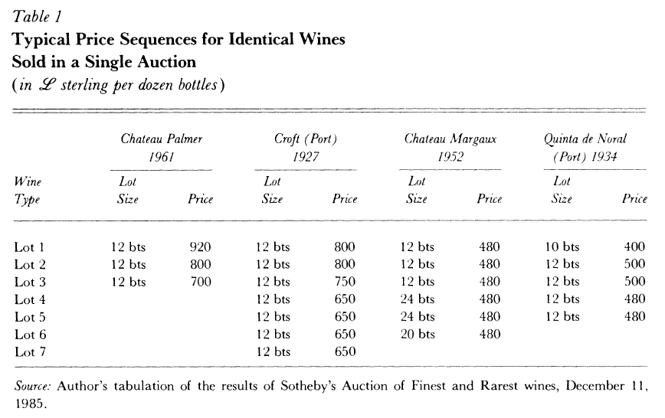
Sotheby Wine Auctions
Source: Ashenfelter (1989, Journal of Economic Perspectives)

Slide 5
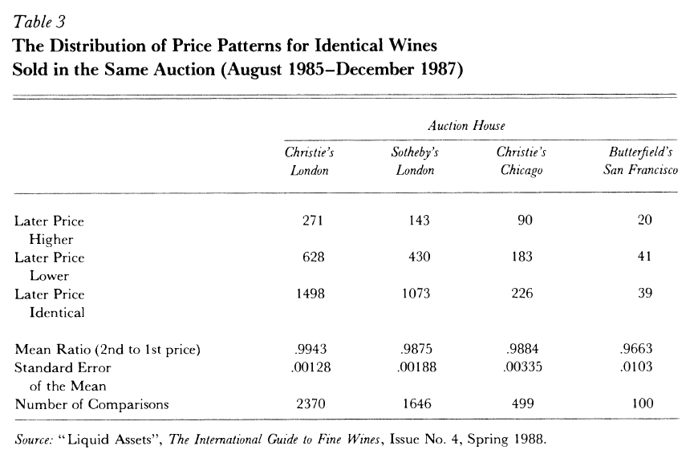
Declining Prices

Slide 6
Why do prices decline?
Ginsburgh (1998, JPE) provides an explanation based on Sotheby’s wine auctions: many bidders are absentee and give instructions “bid up to X for one case of Y”.
Bidder | Max Bid
A | 120
B | 110
C | 100
D | 90
If there are three cases, prices will be 110, 100, and 90.

Slide 7
Optimal sequential bidding
What happens if bidders are more sophisticated?
  Optimal response to declining prices is to sit back in early auctions, and bid more aggressively later.
  If we follow this logic to equilibrium, arbitrage prevails.
“Weber’s Theorem” says that in equilibrium, prices should follow a random walk: E[p_{t+1}|p₁…p_{t}]=p_{t}
Nevertheless, “declining price anomaly” appears so often (in art, cattle, wool, etc.), it’s still something of a puzzle.

Slide 8
Simultaneous Auctions
Consider auction for k identical items.
Possible “one-shot” auction methods
  “Uniform price” (clock and sealed bid)
  “Discriminatory price” (pay-your-bid and Vickrey).
We’ll see that one important issue is whether bidders want just one unit, or potentially want to win several.

Slide 9
“Uniform price” auctions
Sellers often want to run an auction in which all winners pay the same “uniform” price.
  Perceived as “fair”; achieves “price discovery”
Uniform price formats
  Clock auction: seller announces a sequence of prices and bidders name quantities until a market-clearing price is found and auction ends.
  Sealed bidding: participants bid a price-quantity schedule and bids are used to determine the uniform market-clearing price.

Slide 10
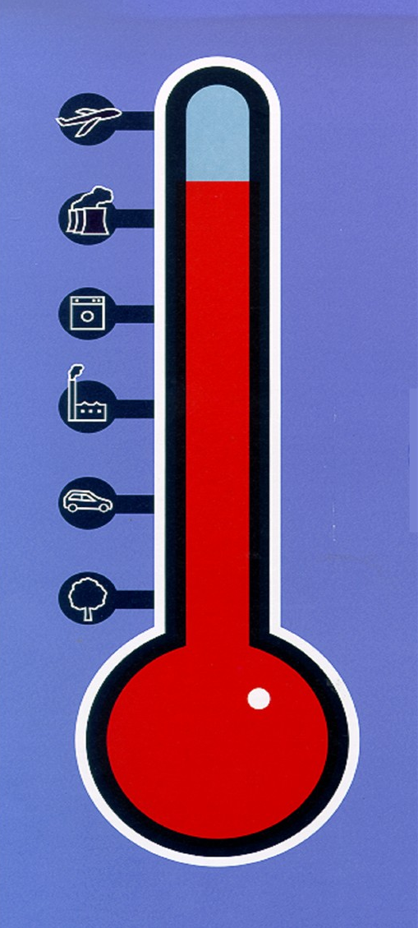
British CO₂ Auctions
Greenhouse Gas Emissions Trading Scheme Auction, United Kingdom, 2002.
UK government aimed to spend 215 million British pounds to get firms reduce CO₂ emissions.
Clock auction used to determine
  What price to pay per unit?
  Which firms to reward?
Notes:
Since this was a procurement auction (the gov’t procured emission reductions), it was run as a descending “clock auction”. Designed and run for DEFRA (British equivalent of EPA) by Peter Cramton, Larry Ausubel and Eric Maskin (and coded by Ulrich Gall!). Clearing defined by price × quantity ≤ budget of £215 million. Clock started at a price of £100 per metric ton and descended to a clearing price of £53.37 per metric ton.

Slide 11
Greenhouse Auction Rules
Auctioneer calls out price, starting high and decreasing.
Each round bidders state tons of CO₂ they will abate
  Tons abated can only decrease as prices decrease.
Auctioneer multiplies tons of abatement times price.
  If total cost of offered supply above budget, lower price.
  When total cost below budget, auction ends and that allocation is implemented
Actual UK auction results
  38 bidders (34 winners), 4m metric tons of CO₂ reduction.
  Price per metric ton: £215m/4m= £53.75

Slide 12
Graphical treatment
P
UK “Demand Curve, defined
so that Q*P(Q)=£215m
p₁
p₂
Falling prices
trace out a
“supply curve”.
p*
Q

Slide 13
Sealed bid version
Uniform-price sealed bid auction
  Auctioneer posts its demand curve
  Bidders submit “supply curves” - i.e. how much they will supply at each price.
  Individual supply curves are aggregated to form an aggregate supply curve.
  Price is set so that supply = demand.

Slide 14
Sealed vs clock: does it matter?
Depends on the information released to bidders
  Suppose bidders in the clock auction observe only the prices and that prices decline in a fixed sequence.
  Bidders are being asked to reveal their supply curves from the top down, with no new information each round other than that the current price is relevant.
  So the auction is strategically equivalent to sealed bidding in which supply curves are written down in advance.
Of course, if more information is released during a clock auction, bidders can adjust their bidding in response to competition - why might this happen?

Slide 15
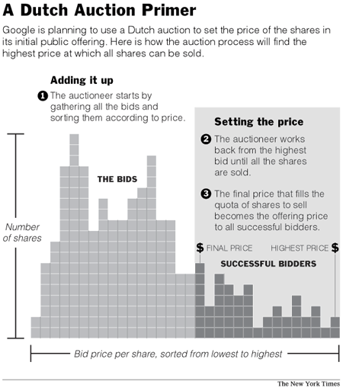

Google’s Auction IPO
Uniform price sealed bid.
Bidders submit demands for shares at different prices.
Bankers construct market demand curve and intersect with supply (price = $85).

Slide 16
Incentives with Uniform Price
N bidders, K identical items for sale.
Uniform price auction format. Either
  Seller runs K+1st price sealed bid auction.
  Seller runs clock auction that ends when demand =K.
Theorem. For a bidder with single unit demand, it is a weakly dominant strategy to bid one’s value.
Proof. Similar to the second price or ascending case.

Slide 17
Demand reduction
Example: three items for sale
  Bidder 1: value 120 and wants 1 item.
  Bidder 2: value 110 and wants 1 item.
  Bidder 3: value 100 and wants 1 item.
  Bidder 4: value 105 and wants 2 items.
Consider what happens with “truthful” bidding
  Bids are 120, 110, 105, 105, 100.
  Three highest bids are winners
  Fourth highest bid is 105 => winners pay 105 each.

Slide 18
Demand reduction
Example: three items for sale
  Bidder 1: 120
  Bidder 2: 110
  Bidder 3: 100
  Bidder 4: 105 and wants 2 items.
“Demand reduction” by bidder 4
  If he bids 105, 105, he wins 1 item and pays 105.
  If he bids 105, 100, bids are 120, 110, 105, 100, 100.
  He still wins 1 and lowers the price to 100!

Slide 19
Example, cont.
Example: three items for sale
  Bidder 1: 120
  Bidder 2: 110
  Bidder 3: 100
  Bidder 4: 115 and wants two units.
Demand reduction by bidder 4
  Bid 115 for both units => wins two, price = 110.
  Bid 115 for first unit, 100 for second => wins 1, p=100.
  Bidder four optimally exercises “market power”.

Slide 20
“Low price” Equilibria
Demand reduction in uniform price auction sometimes can lead to very low prices.
Example: three units, three bidders.
Bidders value units at 10, each wants 2 units.
What is the competitive price?
What might happen in a clock auction?

Slide 21
“Low price” Equilibria
Example: three units, three bidders.
Bidders value units at 10, each wants 2 units.
Clock starts at zero, each demands 1 unit.
Auction ends: bidders split units at price of zero!
A bidder who wants to try for a second unit, will have to drive the price all the way up to 10 - not a good move.
The zero price outcome is a Nash equilibrium!

Slide 22
Making supply elastic
Suppose seller offers
  To sell 3 units at any price
  To sell 4 units if (and only if) price exceeds 4
In clock auction, price will be at least 4.
  If all bidders demand 1 at p=0, auction ends immediately.
  But a bidder can demand 2 until p=4. At p=4, supply will increase to equal demand, and auction ends. Better to win 2 units at p=4 than 1 at p=0. Profit: 2*(10-4)=12 > 10.
Somewhat surprisingly, seller has managed to increase supply and yet also increase prices!

Slide 23
Uniform Price Summary
Uniform price auctions have desirable properties
  Fairness: identical goods sell for identical prices
  Simplicity: auction price equates demand and supply.
Demand reduction is a primary concern
  If bidders want more than one unit, they have an incentive to bid less than their true demand in order to reduce price.
  Demand reduction can also interfere with efficiency: a standard problem when firms exercise market power.
  If supply is inelastic, it can also lead to very low prices - a possibility in both clock and sealed bid auctions.

Slide 24
Discriminatory Price Auctions
Alternative is a “pay-your-bid” format
Bidders submit bids (demand curves)
Seller finds price where supply=demand
All bids above clearing price are satisfied, but winners pay their bid rather than the clearing price.
How should bidders adapt their bidding?

Slide 25
Example
Example: three items for sale
  Bidder 1: 120
  Bidder 2: 110
  Bidder 3: 100
  Bidder 4: 105
Suppose “truthful bids”: 120, 110, 105, 100.
Outcome: 1, 2, 4 win and pay 120, 110, 105.
Is this an equilibrium? Why or why not?
Equilibrium is for everyone to bid 100!

Slide 26
Example, cont.
Example: three items for sale
  Bidder 1: 120
  Bidder 2: 110
  Bidder 3: 100
  Bidder 4: 105, 105 - wants 2 units.
What if bids are 105, 105, 105, 105, 100?
Not an equilibrium: bidder 4 should reduce bid to 100, 100.
What if bidders 1,2,4 bid 100+ε, and 3 bids 100
Not an equilibrium: bidder 4 should bid 100+2ε,100+2ε.
No simple Nash equilibrium - equilibrium involves mixed strategies with bids between 100 and 105!

Slide 27
Discriminatory Auctions
Naive view of discriminatory auctions: opportunity to extract more money from “high-value” bidders.
  But bidders compensate with more “demand reduction” - bid “flatter” demand curves that anticipate clearing price.
Comparison with uniform price auction is tricky
  Both auctions can be inefficient and encourage demand reduction: no clear efficiency or price ranking.
  Sometimes hear that uniform price is better for small bidders: easier to participate and get the “market price”.

Slide 28
Treasury Auctions
Long-standing debate on uniform vs discriminatory.
US used discriminatory until 1992, then switched.
Studies of change don’t find big differences
  In both cases, auction prices are quite similar to prices before the auction in the “when issued” market.
  Some evidence than smaller bidders increased their market share after switch to uniform price auction.
Explanation? US market is very large and liquid; Maybe rules matter more when market is thinner.

Slide 29
An Efficient Auction?
Example: three items for sale
  Bidder 1: 120
  Bidder 2: 110
  Bidder 3: 100
  Bidder 4: 105, 105 - wants 2 items.
Is there a pricing rule that would make it a dominant strategy for each bidder to bid truthfully – and would lead to an efficient allocation of the items?

Slide 30
Vickrey Pricing
Set price for each winning bidder equal to the value of losing bids that the bidder displaces.
Algorithm for finding Vickrey outcome given bids
  Allocate items in order to maximize bidder value.
  To find payment of bidder i: (a) Compute value obtained by all bidders except i; (b) Drop i’s bids and compute the maximum value those bidders would have obtained if i hadn’t participated. Charge i the difference of (b)-(a).
Vickrey pricing makes bidding truthfully a dominant strategy, but Vickrey prices are not uniform prices!

Slide 31
Vickrey Pricing
Example: three items for sale
  Bidder 1: 120
  Bidder 2: 110
  Bidder 3: 100
  Bidder 4: 105, 105 - wants 2 items.
Vickrey pricing if truthful bids: 120, 110, 105, 105, 100.
  Bidders 1 and 2 win, pay 105 each (displace 4).
  Bidder 4 wins one unit, pays 100 (displaces 3).

Slide 32
Vickrey Pricing, cont.
Example: three items for sale
  Bidder 1: 120
  Bidder 2: 110
  Bidder 3: 100
  Bidder 4: 115, 115 - wants 2 items.
Vickrey pricing if truthful bids: 120, 115, 115, 110, 100.
  Bidder 1 wins and pays 110 (displaces bidder 2).
  Bidder 4 wins two units, pays 100 for first unit (displaces bidder 3) and 110 for second (displaces bidder 2).

Slide 33
Summary
Multiple units can be sold sequentially or simultaneously.
  Sequential auctions can be simple - one unit at a time.
  Simultaneous auctions can be designed to yield a uniform price.
Uniform price auctions can lead to concerns about the exercise of market power
  Demand reduction when bidders want multiple units
  Possibility of low price “collusive seeming” equilibria.
Discriminatory price auctions are an alternative, and are sometimes viewed as a way to extract value from high value bidders, but revenue implications generally unclear.
Vickrey auction can eliminate demand reduction and restore efficiency, but the uniform price property is lost.

